Slide 1
22CS026
Campus Connect
Unified University Engagement Platform
Team Members:
Bhuvesh Mittal(2210991450)
Daanushi Sharma(2210991469)
Supervised By: Ms. Preenu Mittan
Department of Computer Science and Engineering
Chitkara University, Punjab

Slide 2
TABLE OF CONTENTS
Introduction
Abstract
Problem Statement
Software Development Life Cycle Diagram
Technical Details
Key Features
Future scope
Conclusion
References/Links used

Slide 3
INTRODUCTION
In today's rapidly evolving academic environments, there is an increasing need for streamlined communication and effective event management within universities. Our project, Campus Connect, addresses this need by creating a digital platform that simplifies the interaction between students, teachers, and university clubs.
The system allows:
Students to view and join upcoming university events, check their attendance, and submit quizzes.
Teachers to manage student attendance, upload quizzes, and view their schedules.
Clubs to post events and notices, enhancing student engagement with university activities.

Slide 4
ABSTRACT
The Campus Connect is an innovative web-based platform aimed at enhancing communication and event management within universities. By providing distinct roles for students, teachers, clubs, and administrators, it enables users to easily access relevant information, participate in events, and manage administrative tasks. The platform supports seamless interaction between students and faculty, simplifying processes like attendance tracking, quiz submissions, and event registrations. With an intuitive user interface and role-specific functionalities, It fosters a collaborative and organized university environment. This project serves as a step towards modernizing campus operations and improving overall efficiency.

Slide 5

PROBLEM STATEMENT
Traditional university management often relies on manual processes, paper records, and disconnected systems, leading to inefficiencies and communication delays. This fragmentation makes it difficult for students and teachers to access essential information like attendance, timetables, and academic records. The key issue addressed in this project is the absence of an integrated platform to manage student data, teacher activities, club events, and administrative tasks, resulting in poor communication and operational inefficiencies within the university.

Slide 6
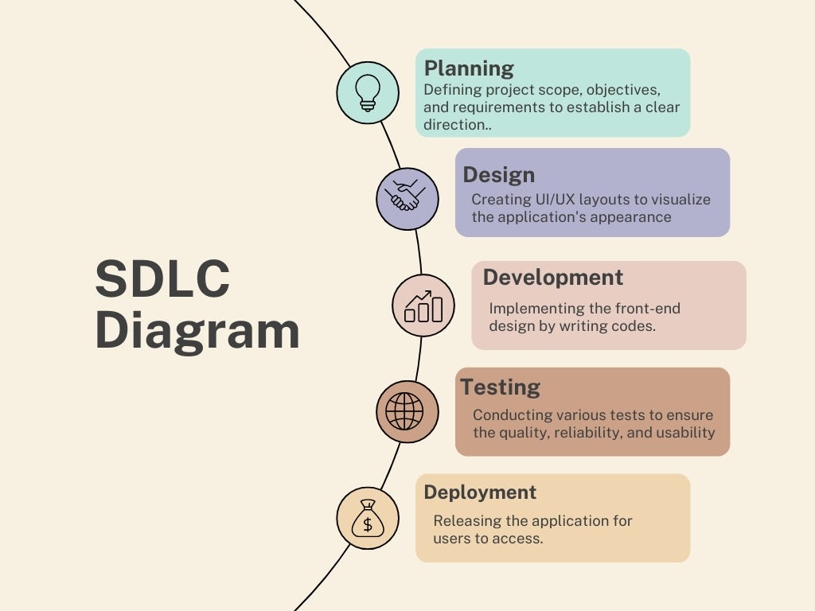
SDLC MODEL

Slide 7



TECHNICAL DETAILS
HTML:
Markup language for creating the structure of web pages.
Utilizes elements like <div>, <p>, <img> to organize content.
Forms for user input, with various input types like text, password, etc.
Semantics for accessibility and SEO.
CSS:
Style sheet language for styling HTML elements.
Box model for layout: content, padding, border, margin.
Selectors and specificity for targeting elements.
Layout techniques like positioning, display, flexbox, and grid.
Responsive design with media queries.
EJS Template:
Dynamic rendering for HTML content based on server-side data.
Supports partial templates for reusable components like headers and footers.
Conditional rendering based on user roles and data.
Enables seamless integration of form handling for login and submissions.
Efficient looping through arrays to render dynamic content like notices and events.

Slide 8



TECHNICAL DETAILS
Backend
MongoDB:
NoSQL database designed for handling large volumes of data.
Uses flexible, JSON-like documents to store data.
Supports dynamic schemas, allowing easy updates to data structure.
Provides horizontal scaling for managing distributed data.
Facilitates fast queries and indexing for efficient data retrieval.
Express:
Express is a minimal and flexible Node.js web application framework
that provides a robust set of features for web and mobile applications.
Express is a lightweight and flexible routing framework with minimal
core features meant to be augmented through the use of Express middleware modules.
Postman:
Postman is a global software company that offers an API platform for developers to design, build, test, and collaborate on APIs.

Slide 9

KEY FEATURES
User Roles:
Separate dashboards for students, teachers, clubs, and admin, providing role-based access.
Event Management:
Clubs can post events, and students can register directly through the platform.
Attendance & Quizzes:
Teacher can upload attendance and quizzes for students to access & complete.
Noticeboard:
Clubs and teachers can post important notices that are easily accessible by students.
Responsive Design:
Mobile-friendly layout for accessing the website on various devices

Slide 10

FUTURE SCOPE
Database Integration : Currently, the system operates without a database. Integrating MongoDB in the future will provide a scalable and efficient way to manage and store data.
Advanced Analytics and Reporting: This will allow administrators and faculty to generate detailed reports on academic performance, attendance trends, and other key metrics. Data visualization tools can also be integrated to present these insights in a user-friendly manner.
Enhanced Security Measures: Future development will focus on bolstering security protocols to protect sensitive information.
Mobile Application Development: To enhance accessibility, a mobile application version of the system could be developed.
Integration with External Systems: The system could be extended to integrate with other university systems and third-party applications.

Slide 11

CONCLUSION
The university management system project aims to streamline administration and academic processes using Node.js, Express.js, EJS, and HTML/CSS, centralizing functions like student profile management, attendance tracking, and mark submissions into a unified platform. It features dedicated dashboards for students, teachers, clubs, and admins, enhancing efficiency and user experience. Future plans include integrating MongoDB for robust data management and implementing security measures to protect sensitive information. This system sets the stage for improved operational efficiency and scalability within the university

Slide 12
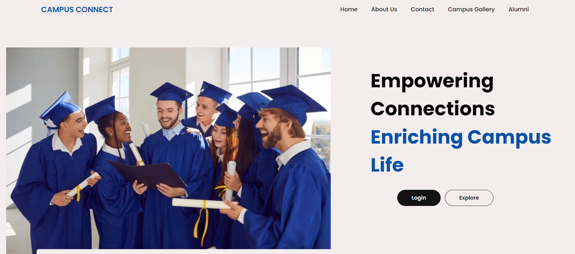
SNAPSHOTS
HOME PAGE :

Slide 13
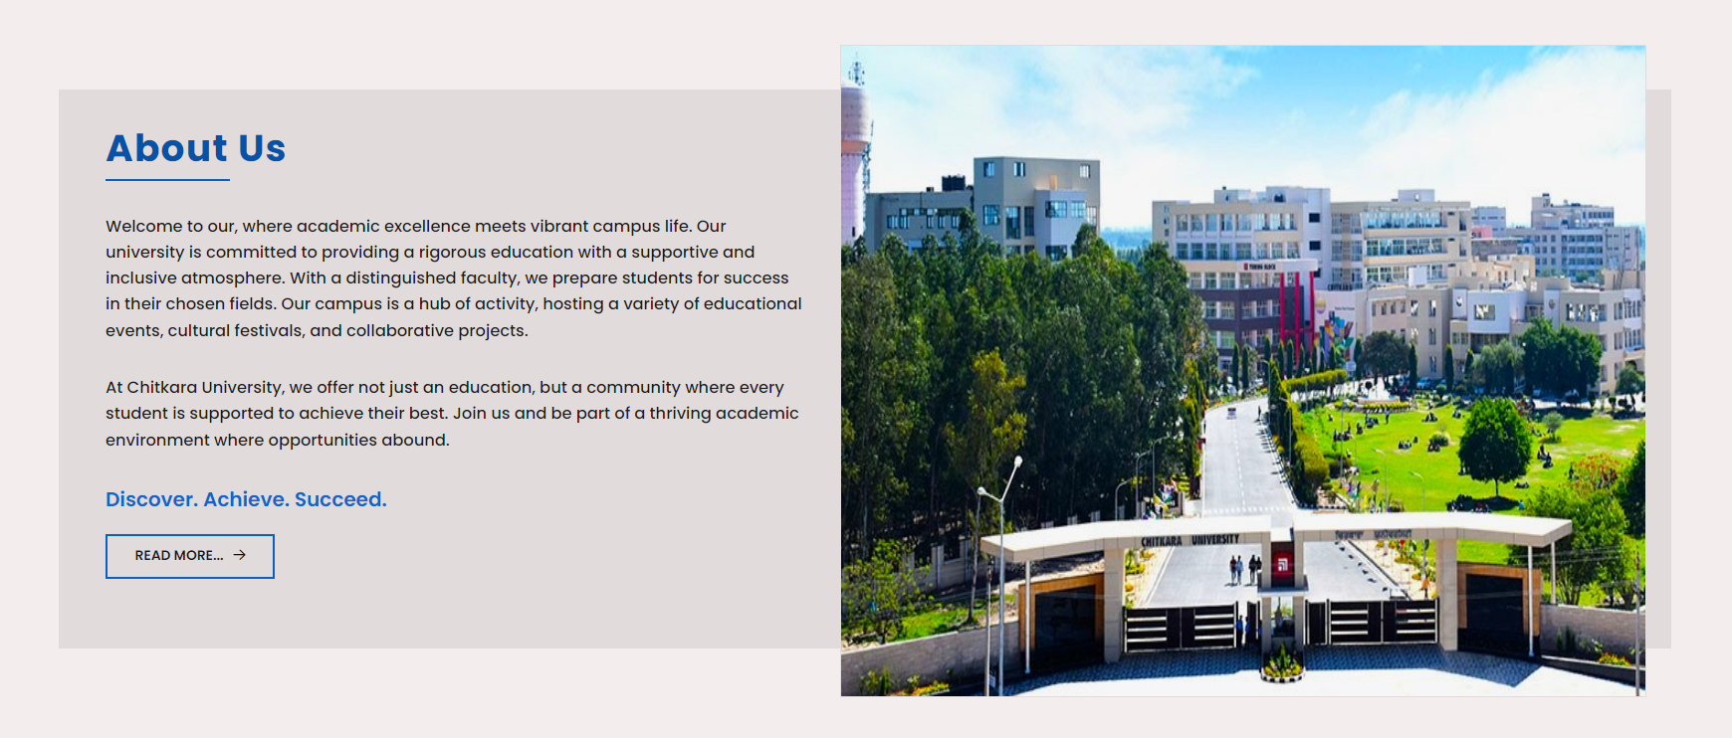
SNAPSHOTS
About-us :

Slide 14
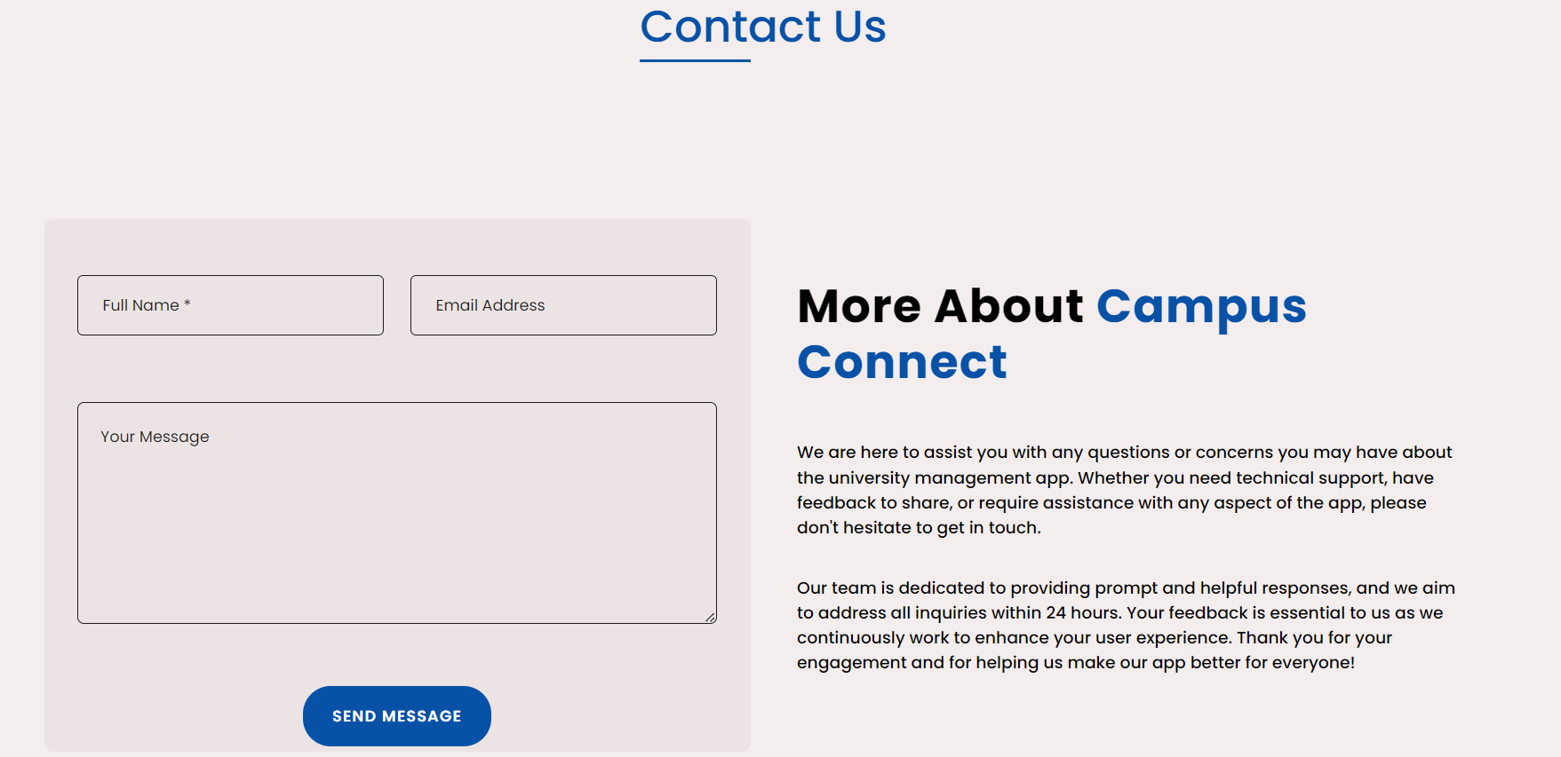
SNAPSHOTS
Contact Us :

Slide 15
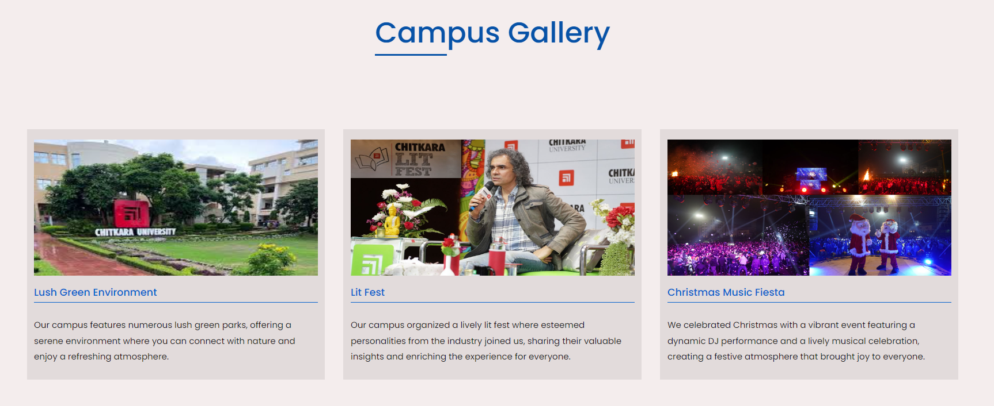
SNAPSHOTS
Campus Gallery:

Slide 16
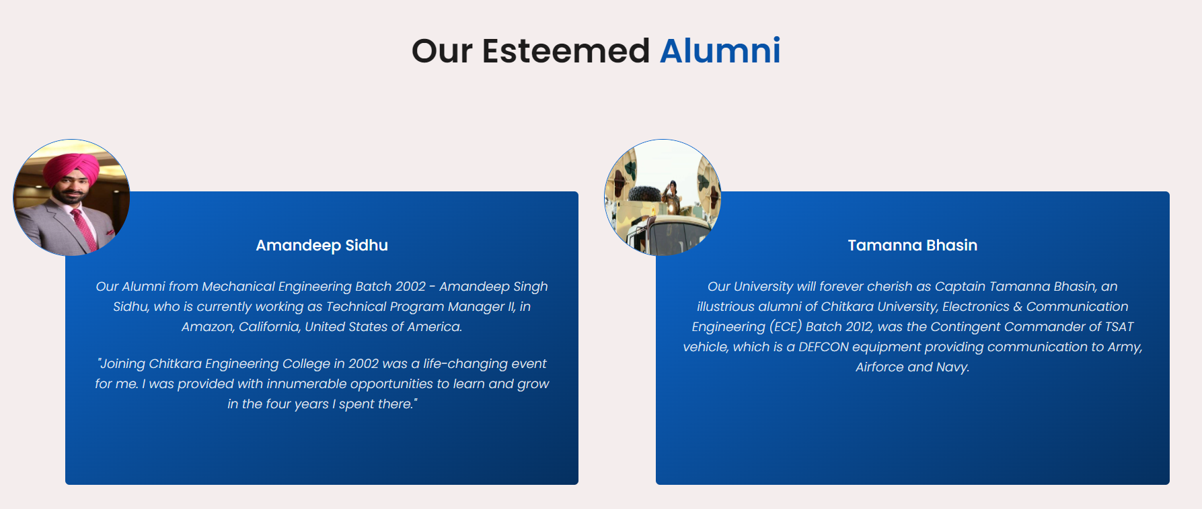
SNAPSHOTS
Alumni:

Slide 17
References/Links used:
https://google.com/
https://youtube.com/
https://github.com/
https://cuiet.codebrigade.com/

Slide 18


